Slide 1
Advertisement Success Prediction
Employability test

Slide 2
Problem Statement
The holiday season is just around the corner—Christmas trees have been decorated, lights and wreaths hung, streets all decked up, Santa costumes rented out, and holiday cards in the mailbox.
Because of holiday cheer, retail brands, big and small, want to earn considerable profits, and therefore, are investing significantly in advertising. These brands have approached an advertising agency to plan and execute ad campaigns that will help them increase the footfall in their stores.
You have been hired by this advertising company to assess the revenue that can be generated by a proposed ad. Based on the demographic information provided, you need to predict whether the revenue generated will cover costs to produce and air the ad(Whether there will be a net gain from an ad or not)
This will help guide decision-making for the firm, as they will want to pursue ads that are likely to generate a net gain for their clients— thereby boosting the advertising firm’s reputation.

Slide 3
Dataset Characteristics
The training dataset contains 19536 records and the test dataset contains 6512 records. Following are the features of the dataset
Feature | Feature type | Description
UserID | Categorical, Nominal | Unique id for each row
ratings | Numerical, float | Metric out of 1 which represents how much of the targeted demographic watched the advertisement
airlocation | Categorical, Nomial | Country of origin
airtime | Categorical, Nominal | Time when the advertisement was aired
average_runtime(minutes_per_week) | Numerical, Integer | Minutes per week the advertisement was aired

Slide 4
Feature | Feature type | Description
targeted_sex | Categorical, Nominal | Sex that was mainly targeted for the advertisement
genre | Categorical, Nominal | The type of advertisement
industry | Categorical, Nominal | The industry to which the product belonged
relationship_status | Categorical, Nominal | The relationship status of the most responsive customers to the advertisement
Target variable | Target type | description
Netgain | Numerical, Classifier | 0 – There is no netgain ; 1 – There is Netgain

Slide 5
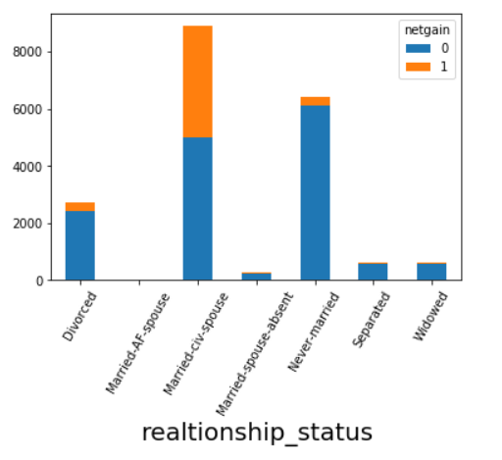
Exploratory Data Analysis
When checked for missing values, There were no missing values found.
Feature and Target class Analysis of categorical data:
50% of the data comprises of the users married to a civilian spouse and the next major relationship status is being never married.

Slide 6
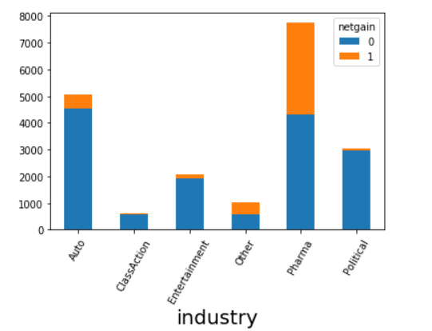
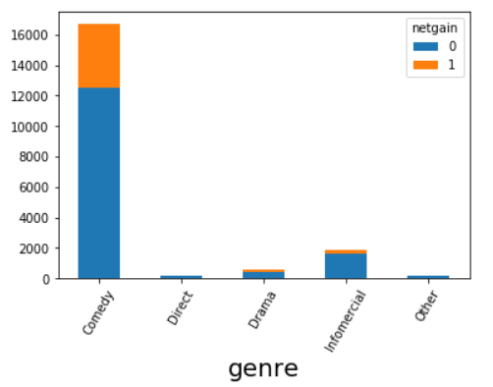
Almost 40% of the users belong to Pharma industry and automobile, political, entertainment industries being 50% of the data.
90% of the advertisement genres is comedy and the other genres being infomercial, Drama, Direct in the 10% of the data

Slide 7
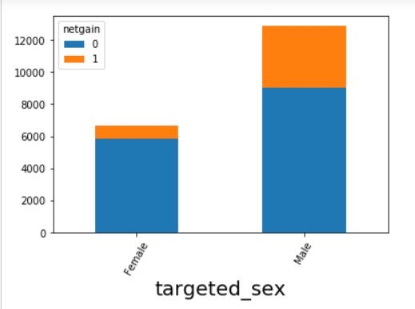
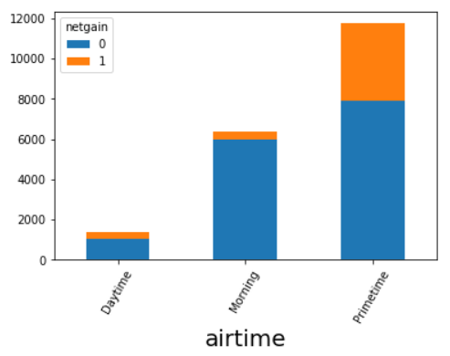
The maximum targeted sex is male i.e. 70%, Female being only 30%
60% of the advertisements are being aired during the prime time, 30% during morning and only 10% during the day time.

Slide 8
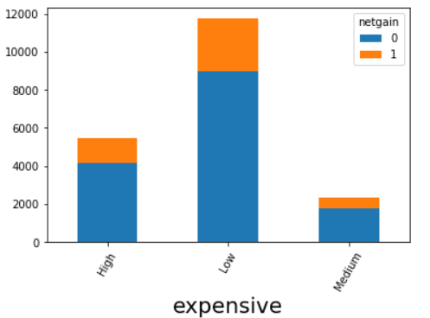
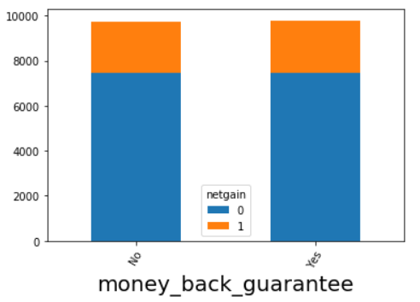
Almost 60% of the ads are less expensive, 30% being highly expensive and 10% being medium expensive.
Half of the ads are having money back guarantee and the other half of them dont.

Slide 9
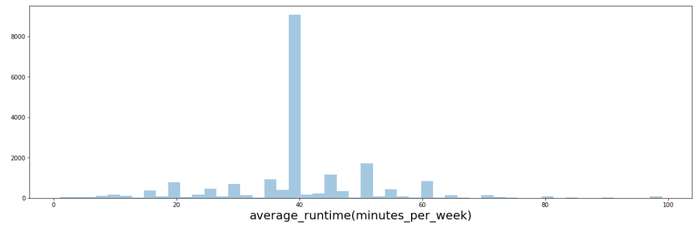
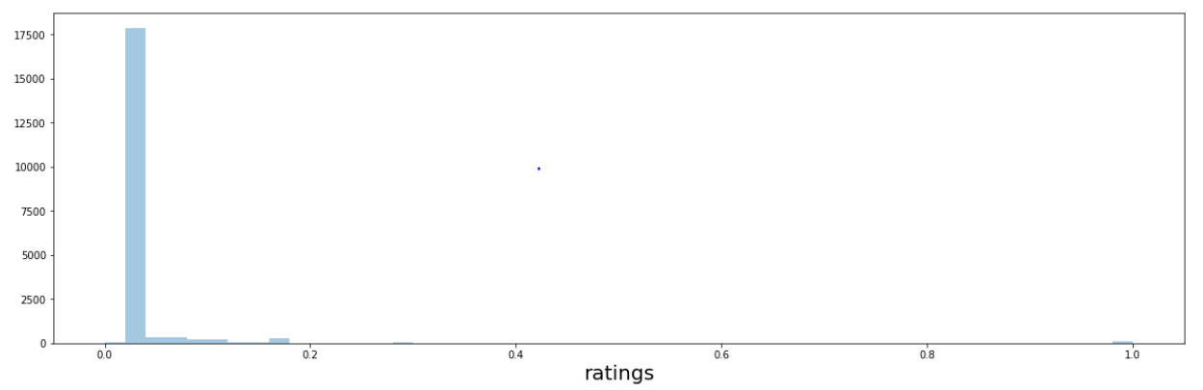
Univariate Analysis of Numerical data
Maximum number of advertisements are between the runtime 35 – 60 mins per week
Most of the ratings have the value 0.0274

Slide 10
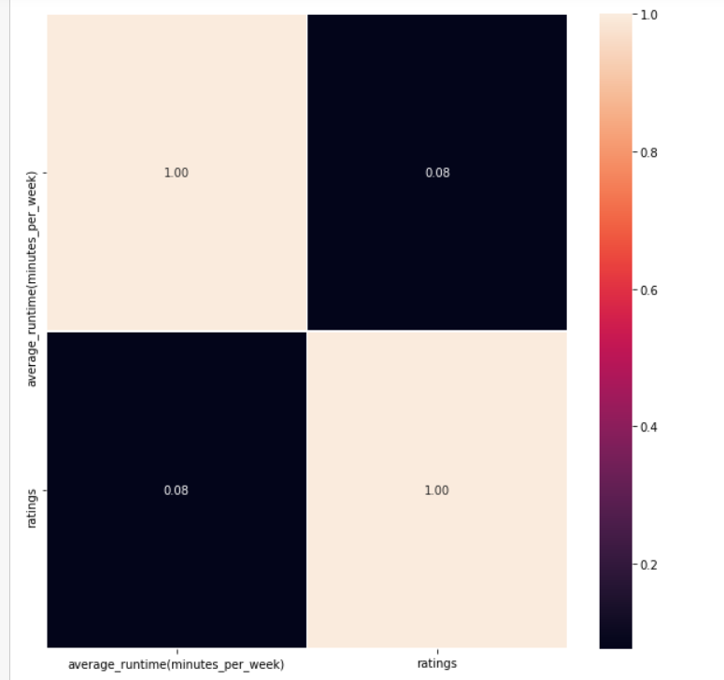
Feature Correlation
Didn’t observe much correlation between the below numeric features. Hence decided to retain both the columns.
Average_runtime(minutes_per_week)
Ratings

Slide 11
Encoding and Data cleaning
Label Encoding was done on all the categorical features.
Since the values in the column average_runtime(minutes_per_week) are highly varying. Normalised this column data using StandardScaler
Since more than 90% of the airlocation data is USA. This column data didn’t seem to be useful to be retained. Hence dropping this column.
Converted the UserID unique identifier column to a numeric column using split function before modelling.

Slide 12
Base line model performance:
Model | F1 Score | Precision | Recall | AUC score
Logistic Regression | 0.0967 | 0.335 | 0.056 | 51.6%
Decision Tree Classifier | 0.501 | 0.503 | 0.498 | 67.16%
Random Forest Classifier | 0.515 | 0.586 | 0.46 | 67.89%
Gradient Boosting Classifier | 0.542 | 0.668 | 0.456 | 69.25
The Best model out of these is Gradient Boosting model.
Since this is a imbalanced class, Sampling would bring out better performance.

Slide 13
Under Sampling and Over Sampling:
 | F1 score | Precision | Recall | AUC score
Tomek Links | 0.533 | 0.55 | 0.51 | 69.1%
Random Undersampler | 0.62 | 0.48 | 0.86 | 78.66%
SMOTE | 0.579 | 0.458 | 0.786 | 74.6%
Random Sampler is giving the best performace out of all sampling methods.
Hence selecting Grandient boosting + random sampler for prediction

Slide 14
To improve predictability
Augument existing data with more data: Like the arilocation column with more countries included would have made this feature valuable.
Ratings values looks to be some default value selected. If genuine ratings were provided this would increase the performance.
Adding more features like channel details where ads are posted, Frequency of ads getting updated, Is the channel being changed while the ad is being played.

Slide 15
Thank you

